Slide 1



A Systematic evaluation of the operational 3D-VAR WRF model in Colombian Air Force
Juan Soto, Jhon Edinson, Sara Lorduy, Kevin Chicaeme, Julian Pantoja, Santiago Lopez Restrepo, David Ortega, Andrés Yarce Botero, Olga Lucia Quintero
2nd International Workshop on Data Assimilation and decision making, Medellín, Colombia
1

Slide 2
OUTLINE
1. Work team motivation
Background Air Force Colombia WRF -> WRFDA
2. Methodology
Description of the evaluation procedure
WRF configuration used
Description of data sources to be used
3. Preliminary results of the WRFDA-FAC operating model validation experiments.
4. Current and future job.
2
Notes:
Cómo hacer entender a un tomador de decisiones. Evaluación parametrizacion microfisica del modelo. Sómos capaces de repetirla. Evaluación de la repetición mediante métodos de evaluación

Slide 3
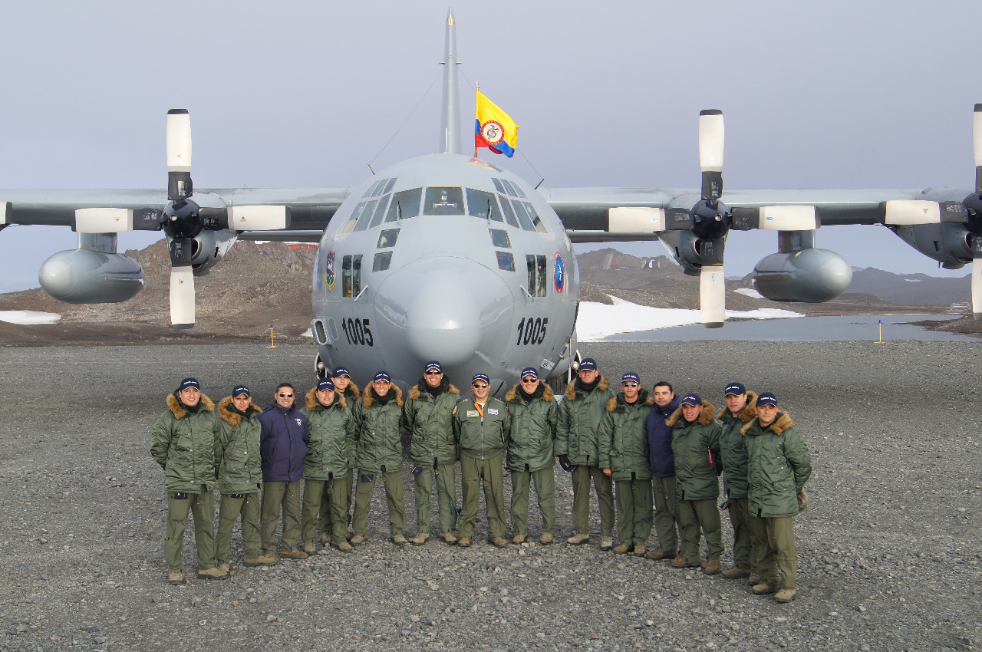
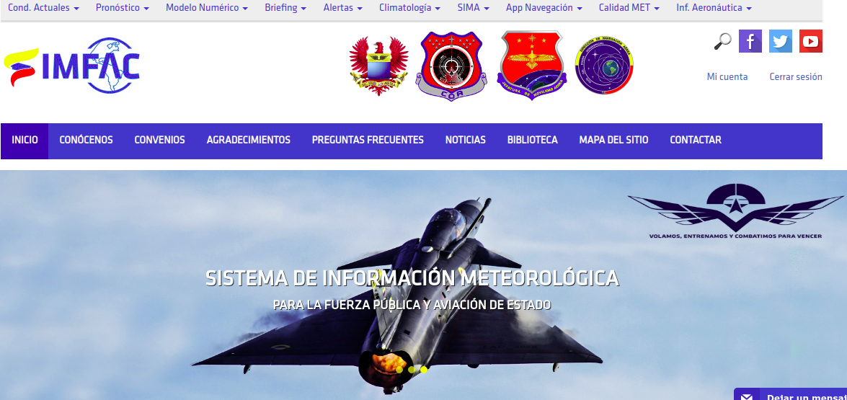
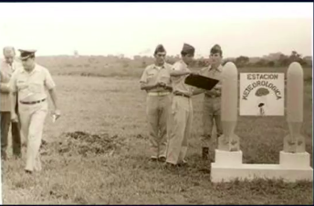
1. Work team motivation
Colombian Air Force (FAC) establish the meteorological area in 1972, with the first three meteorological stations' acquisition, creating in 1998 the aeronautical meteorology section. Since then, it has evolved in its capabilities, intending to apply meteorology to air operations' safety and efficiency.
Currently, it has managed to create a meteorological information system (SIMFAC), a network of meteorological stations at operational bases, measurement of height variables using radiosonde and radiometers, reception of satellite images and radar information from GOES, and operational use of the Meteorological Research and Forecasting Model (WRF).
3

Slide 4
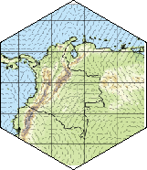
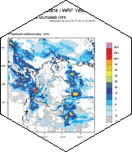
1. Work team motivation
SIMFAC WRF 2.1 2006 Assimilation of METAR and SYNOP
WRF 2.1 WRF 3.3 2012
WRF 3.7
SOUNDING
Assimilation
2016
WRF 4.1 2019 Assimilation of RADAR and GOES data
WRFDA EAFIT FAC Validation 2020
Evolution of the WRF in the FAC
Since the operational implementation of the WRF model in the FAC in 2006, different studies have been carried out that seek to validate the capacity of the model to forecast various meteorological phenomena such as rain (Caceres 2007 and Jimenez 2014), convective systems (Aragon, 2015), fog and mist (Martinez 2015).
4

Slide 5
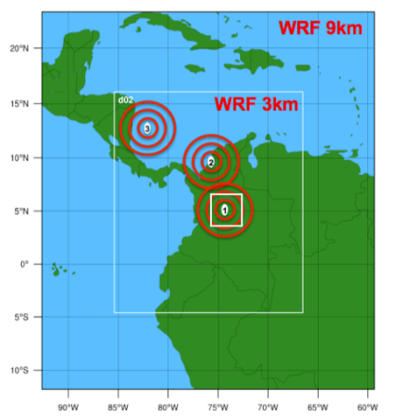
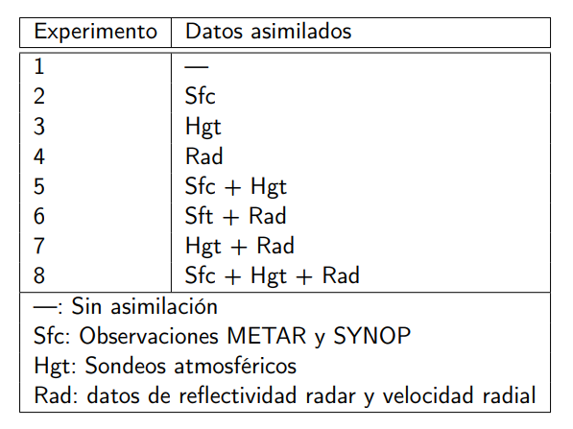
1. Work team motivation
Evolution of the WRF in the FAC
All these investigations have allowed the FAC to implement physical and dynamic parameters that best fit the Colombian territory. In 2019, the simulations of the atmosphere through the WRF model included modules for assimilation of radar and satellite data GOES 16, enhancing the initial conditions of the model, bringing them closer to the conditions observed by these instruments, allowing a more accurate simulation of the evolution of the atmosphere over time.
Observation impact experiment in the WRF assimilation precipitation (Caceres, 2019)
5
Notes:
Similitud de los resultados con respecto a radiosondeos evaluando la precipitación
Conclusión finales de caceres relacionadas a la necesidad de ejercicios posteriores de validación cuantitativa

Slide 6
1. Work team motivation
Does assimilation reduce the model-model, model-data gap errors?
How could we validate the Air Force operational model under conditions of data assimilation?
Which is the nature of the errors presented?(Assimilation or model parametrizations)
Research questions
6

Slide 7
2. Methodology
Static WRF data
FAC WRF assimilated
Validation Observations
Validation
GFS initial and boundary condition
REAL
WPS
Statistical metrics comparison
WRFDA
GOES 16
RADAR
METAR
SYNOP
SONDES
Obsproc
Quality control
ARW
WRF
FAC WRF no assimilated
WPS
GFS initial and boundary condition
7

Slide 8
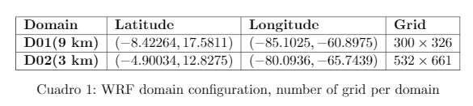
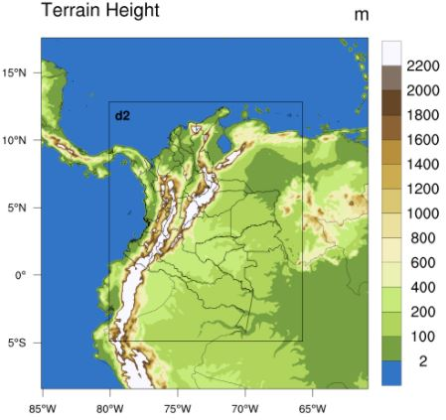
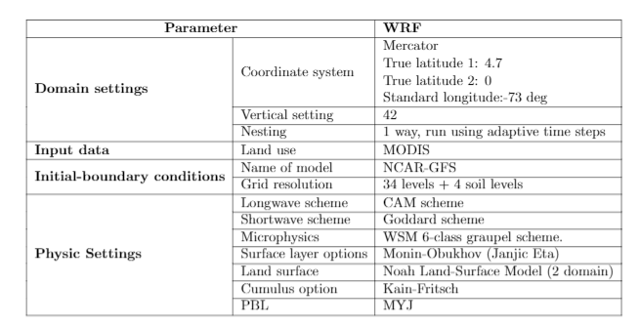
2. Methodology
d01
Domain configuration and WRF parametrizations
8
Notes:
Algún dato sobre operativo

Slide 9
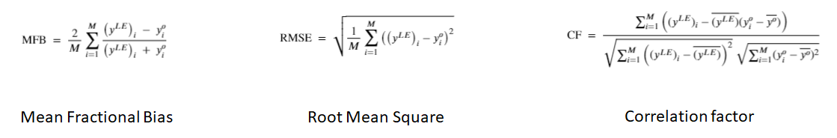
2. Methodology
3DVAR Data assimilation technique
OBSPROC module
Covariance matrix generation through gen_be module
Description of the error statistics used
9

Slide 10
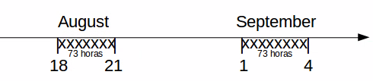
2. Methodology
Assimilated vs no assimilated
T2 Temperature
P Pressure Surface and levels
V10 Velocity V
U10 Velocity U
Precipitation
2020
Codes availables at:
https://github.com/ayarceb/WRFDA_FAC_EAFIT
Simulated data available at:
https://eafit-my.sharepoint.com/:f:/g/personal/ayarceb_eafit_edu_co/EuHk4-UZVQ9JqayzFwaCUfgBVkQnS9kbxWZGwNJvaX9uLg
10

Slide 11
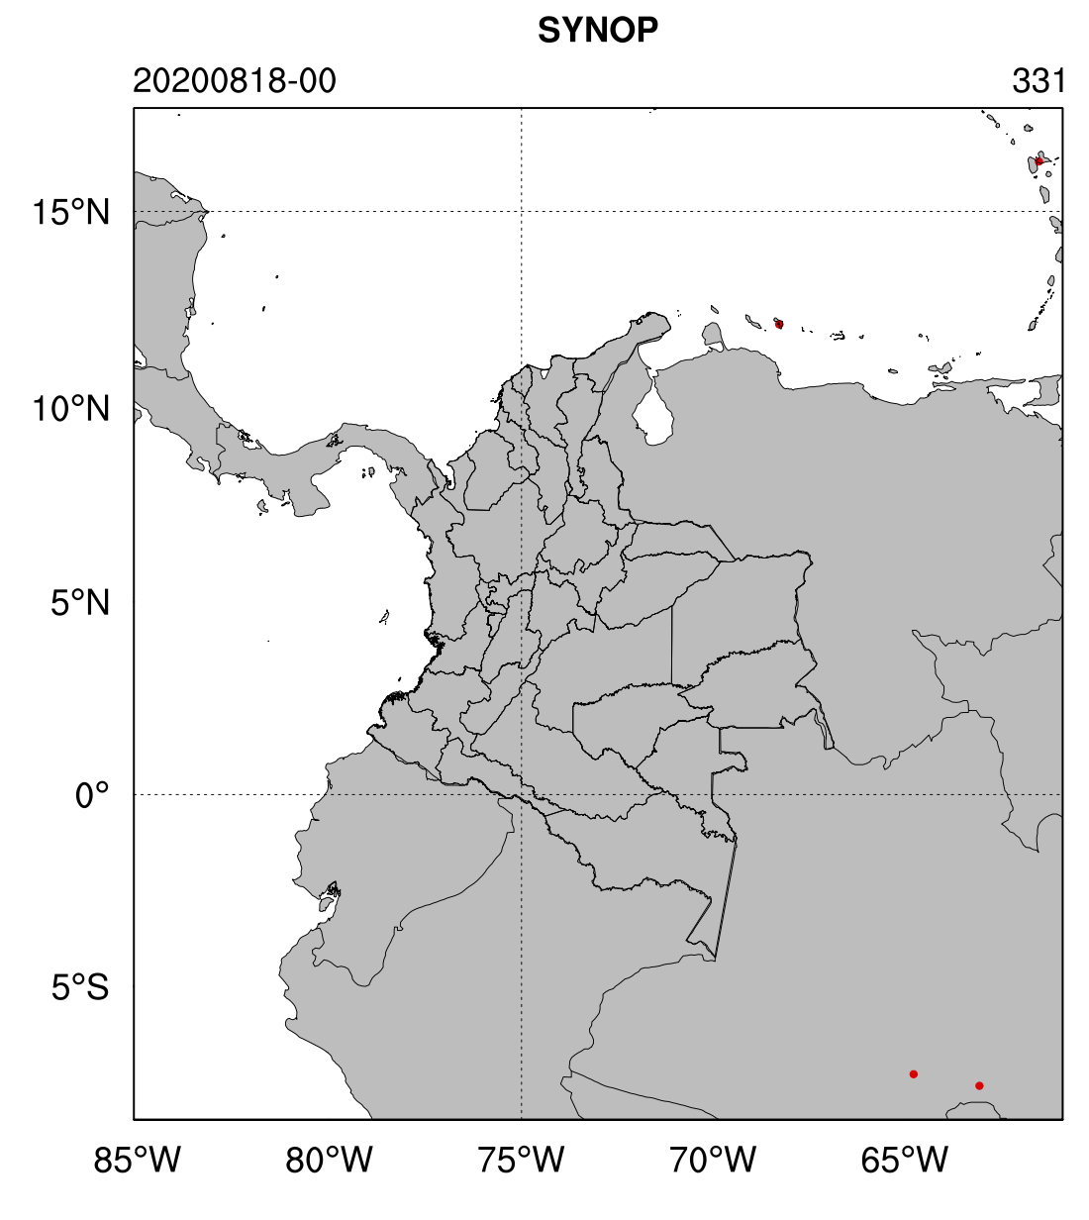
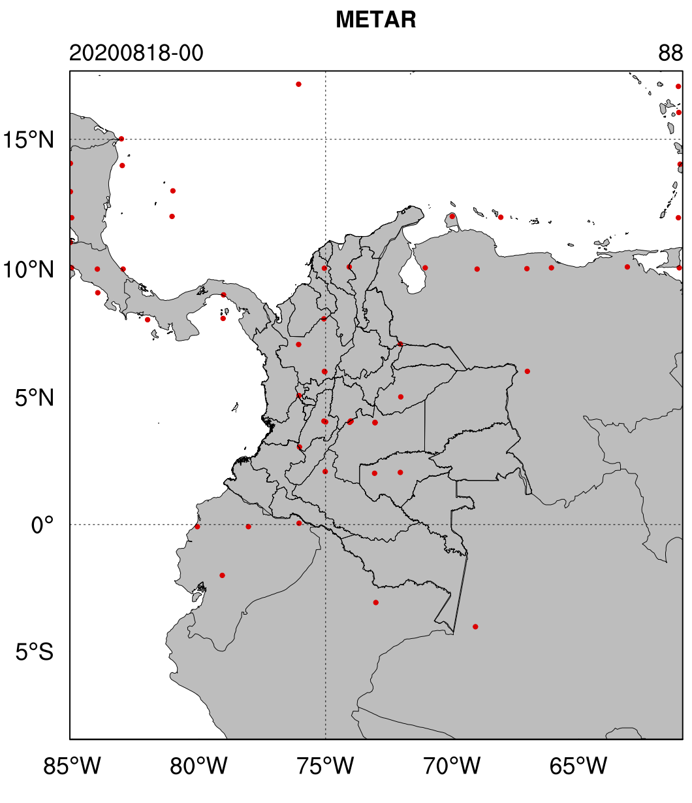
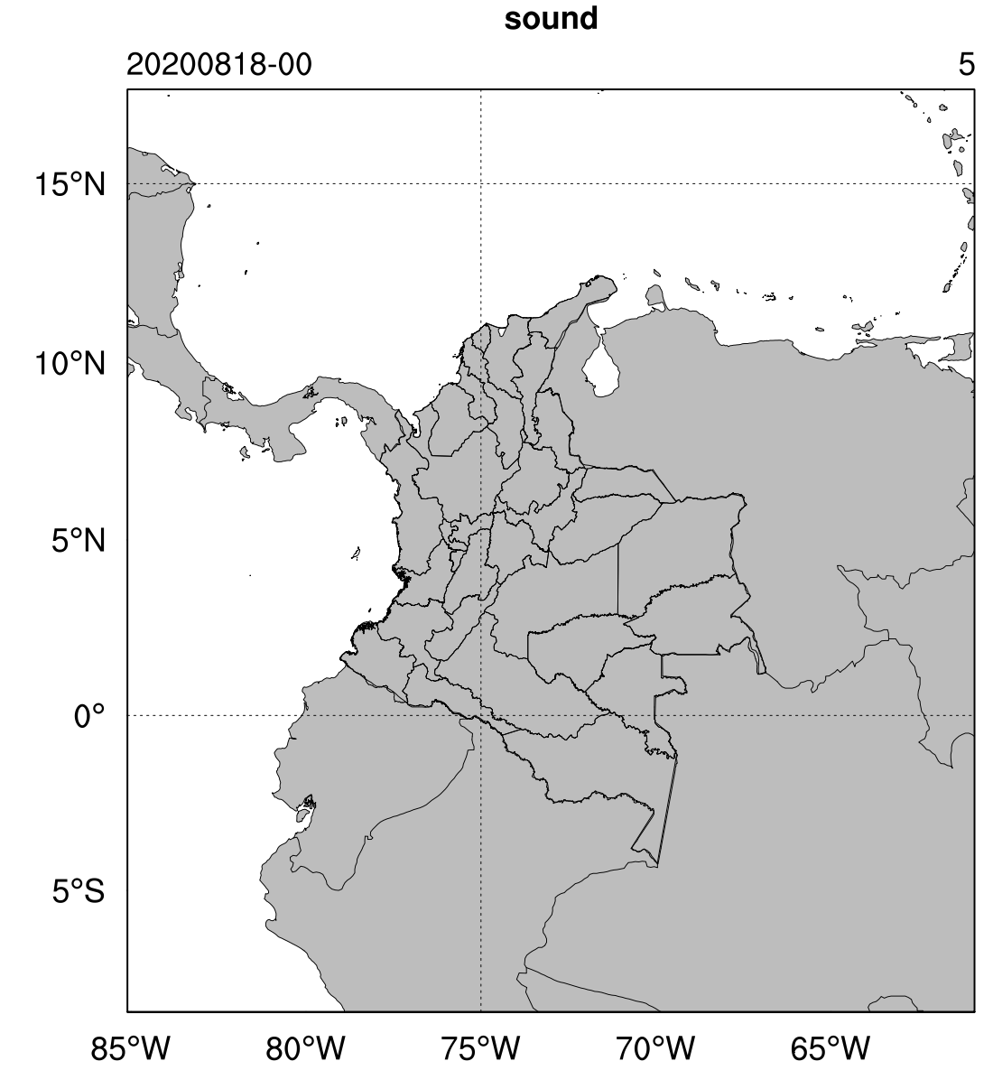
2. Methodology
11

Slide 12
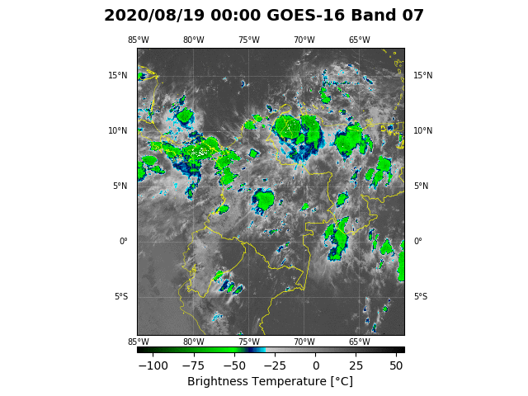
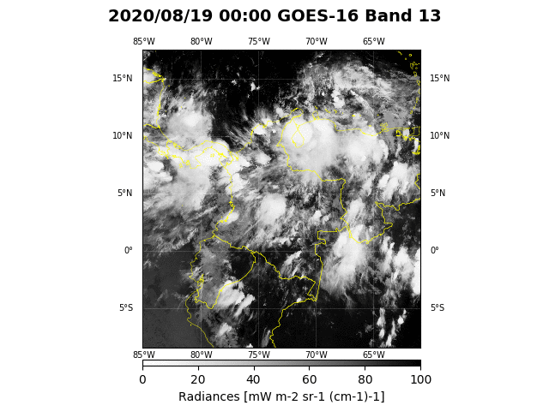
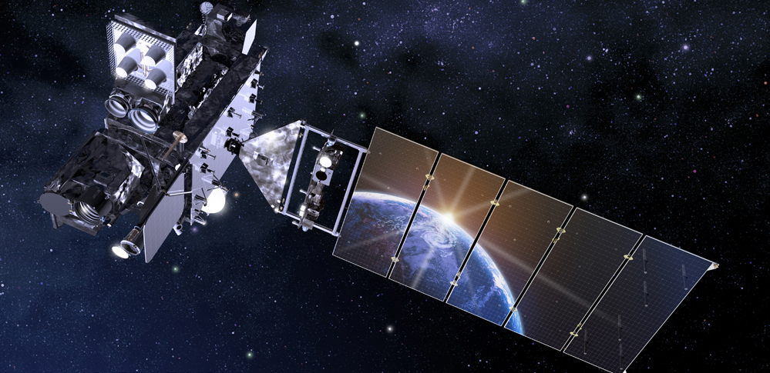
2. Methodology
12

Slide 13
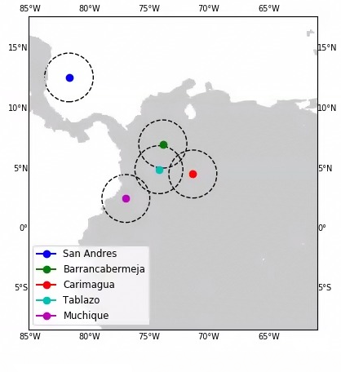
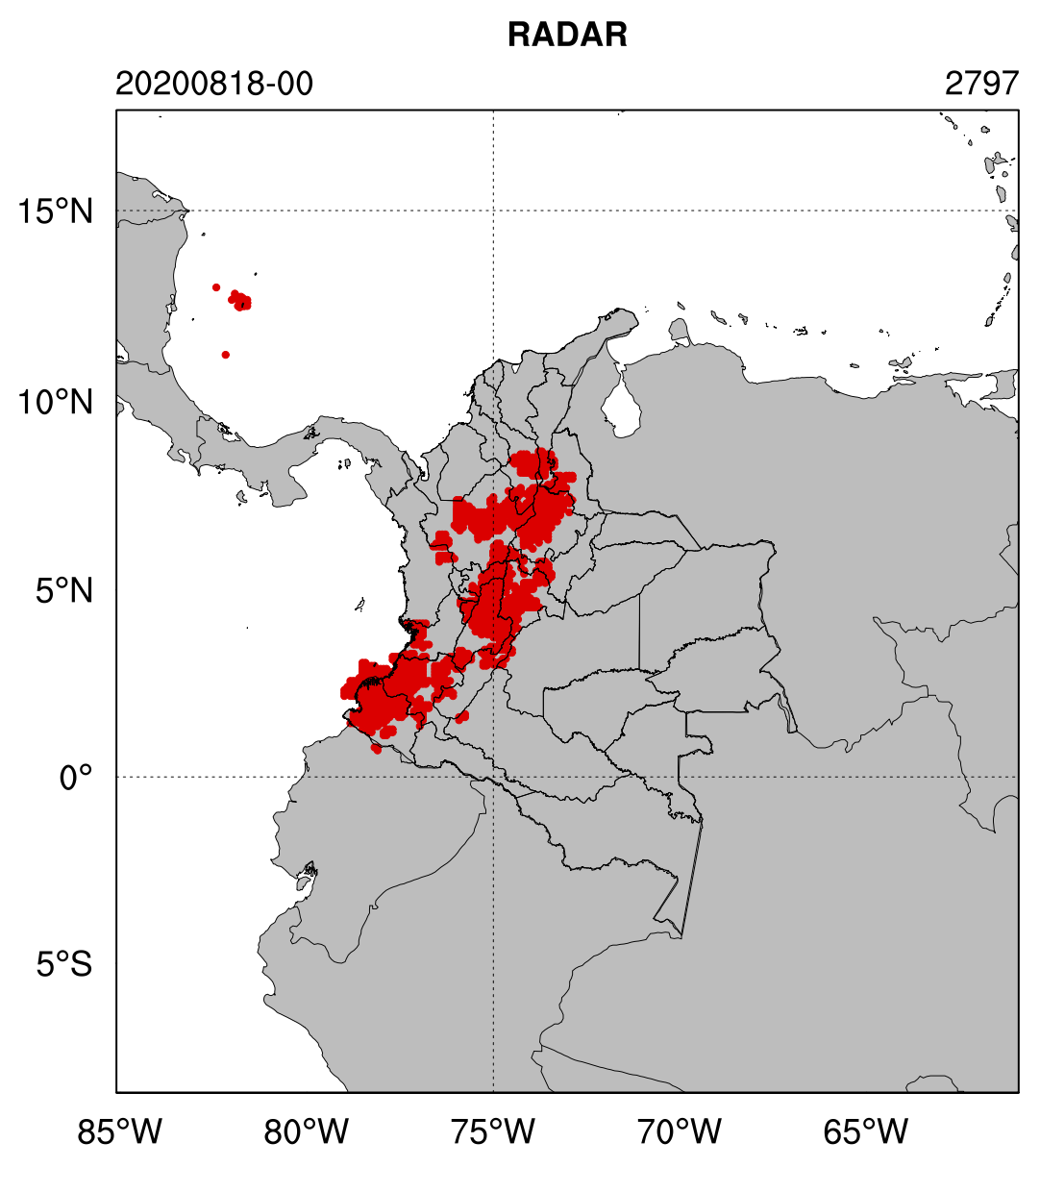
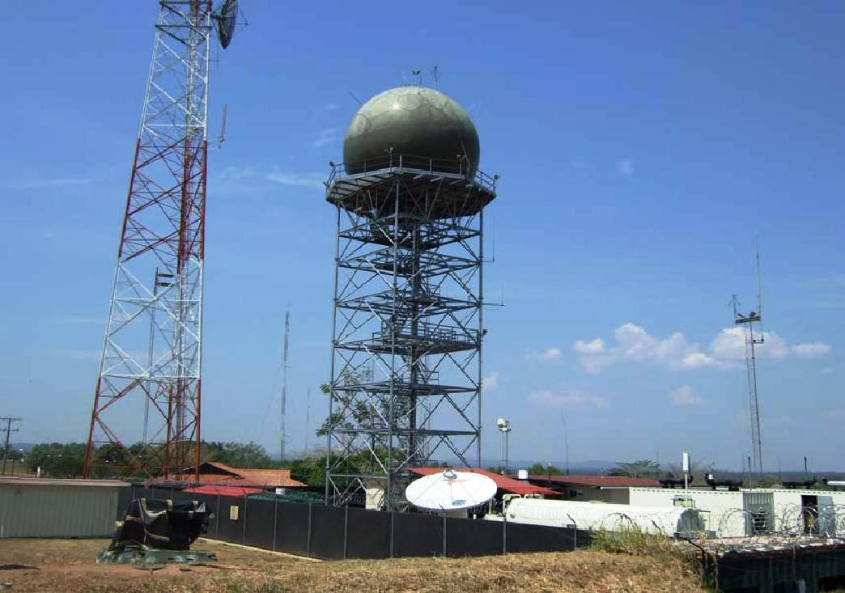
2. Methodology
13

Slide 14
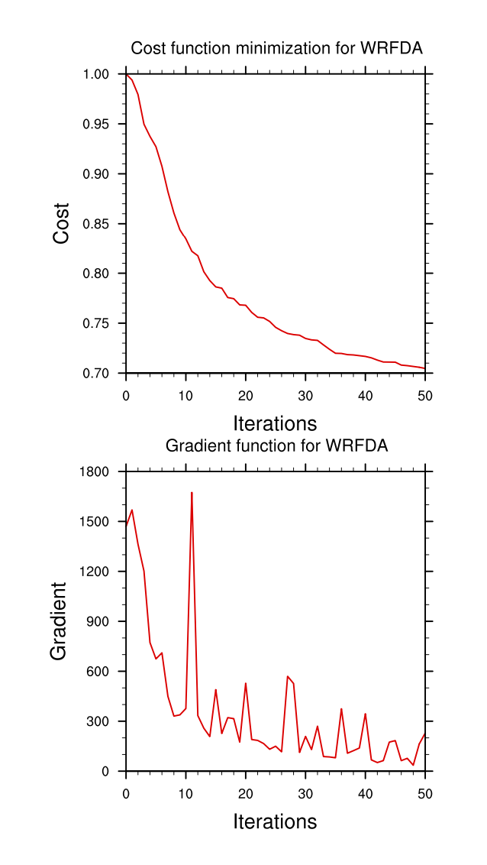
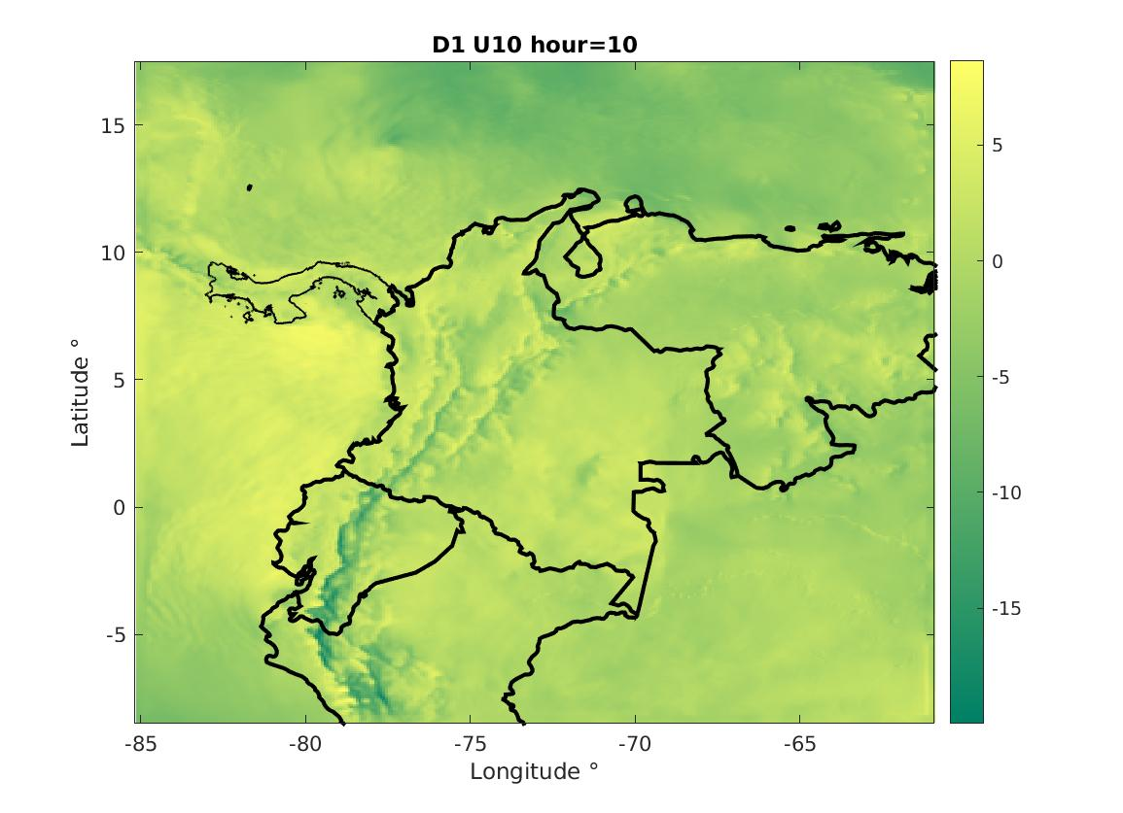
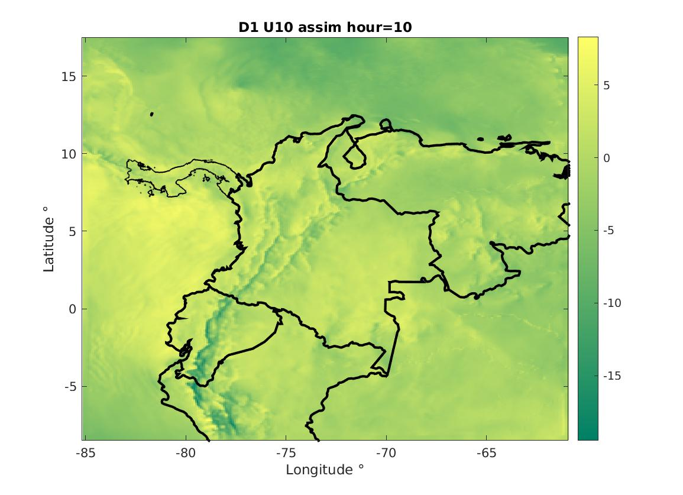
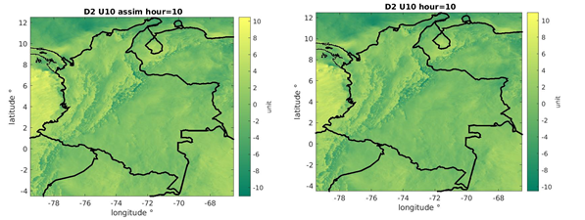
D1
D2
14

Slide 15
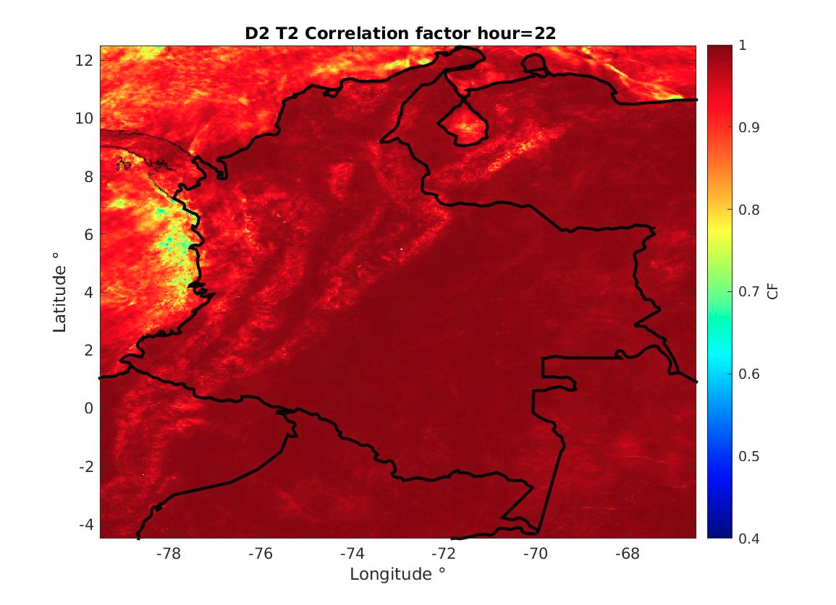
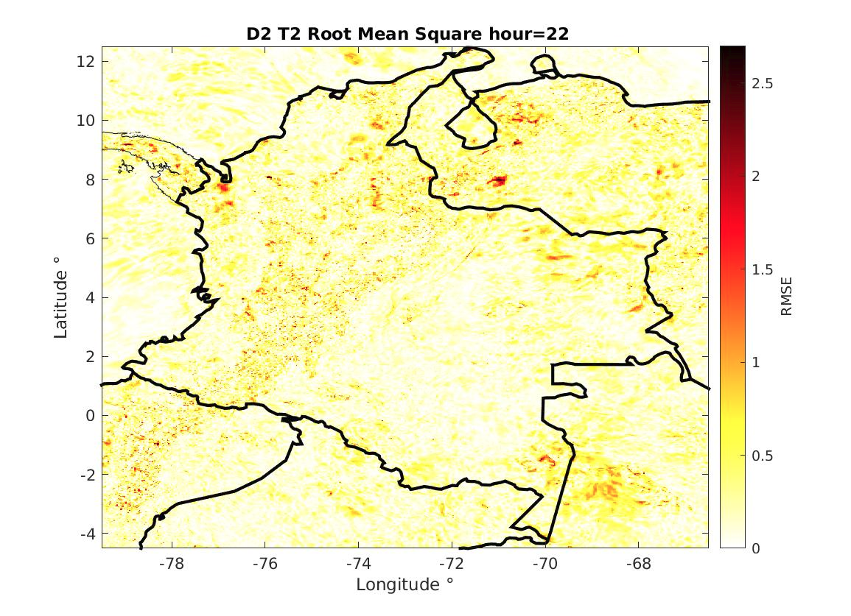
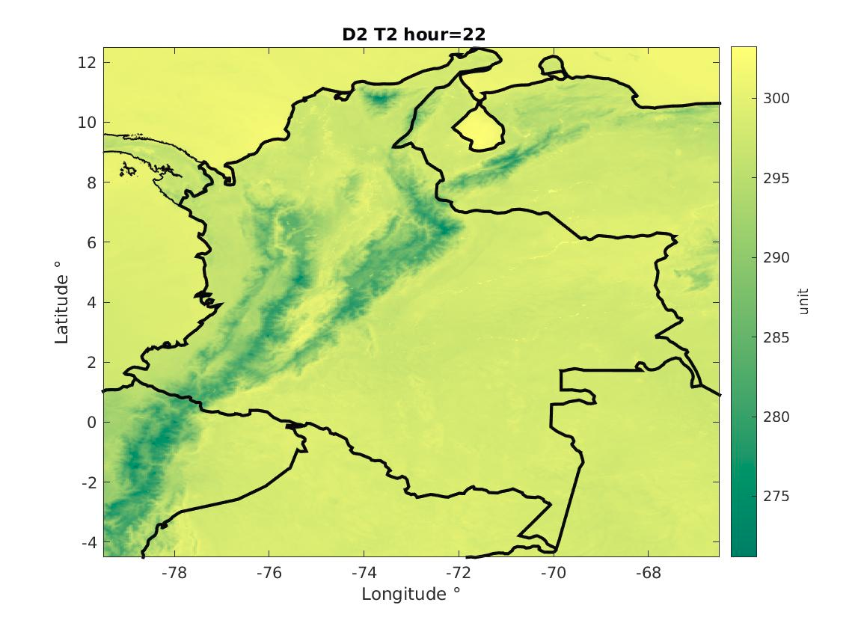

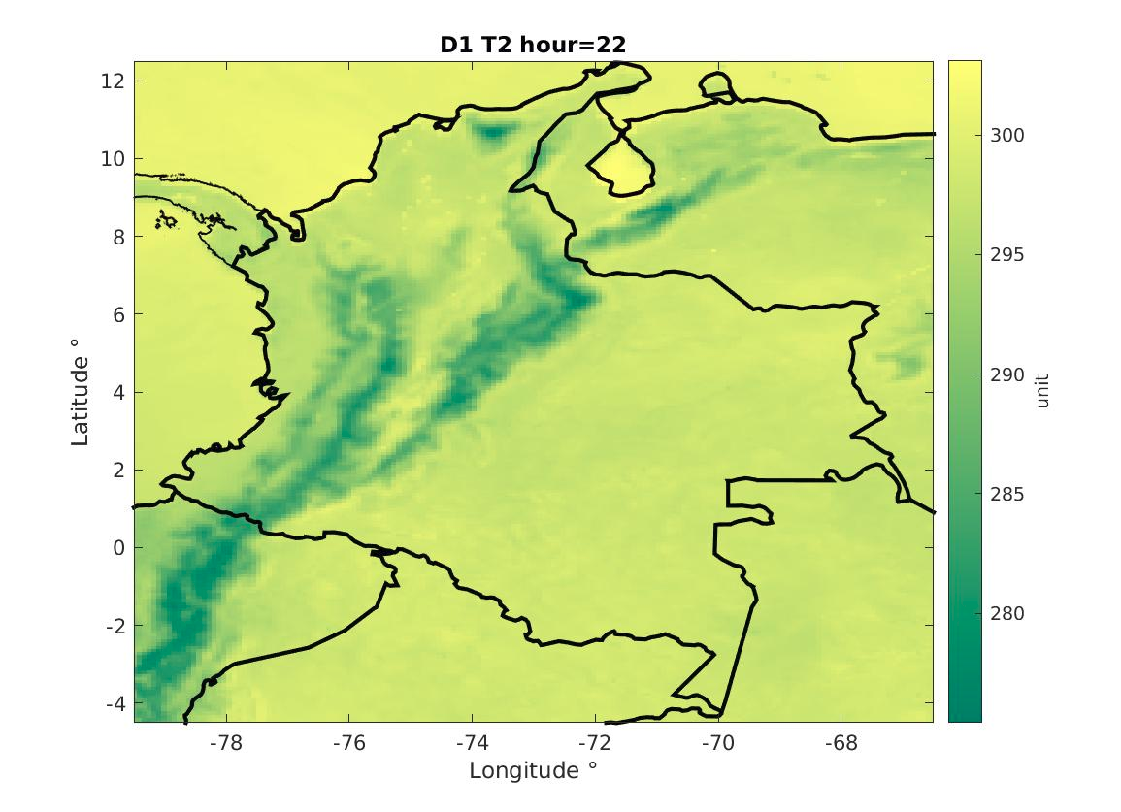
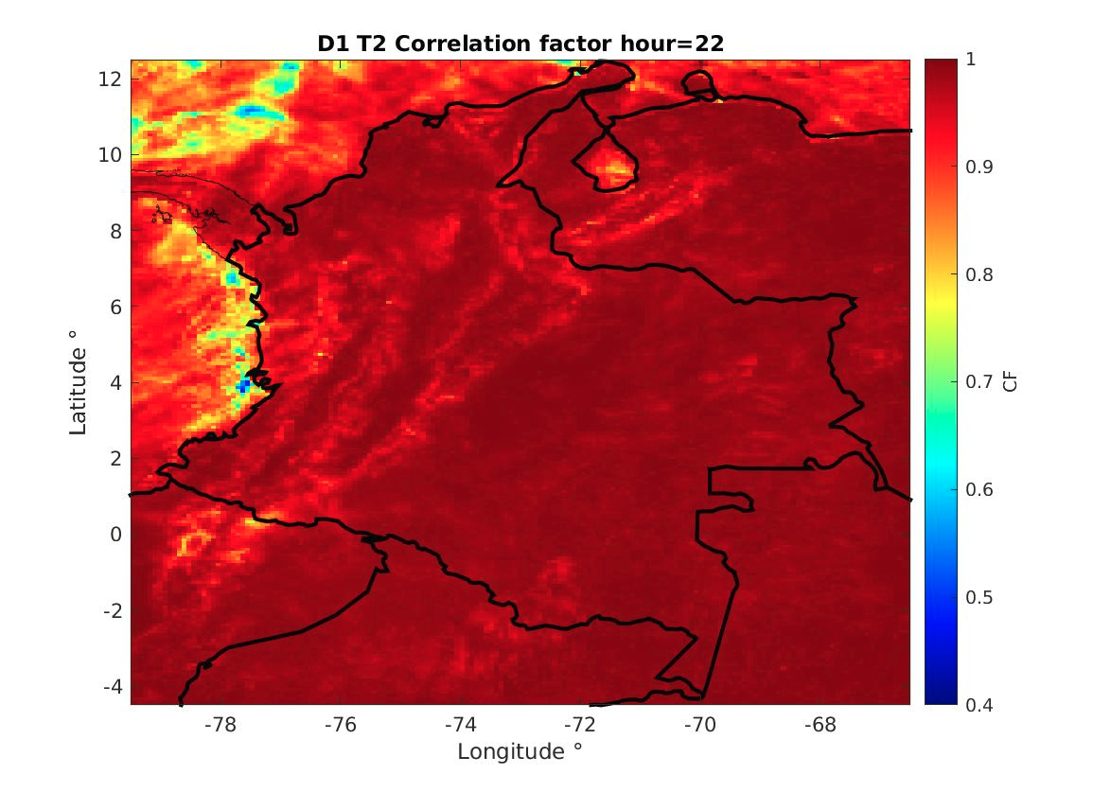
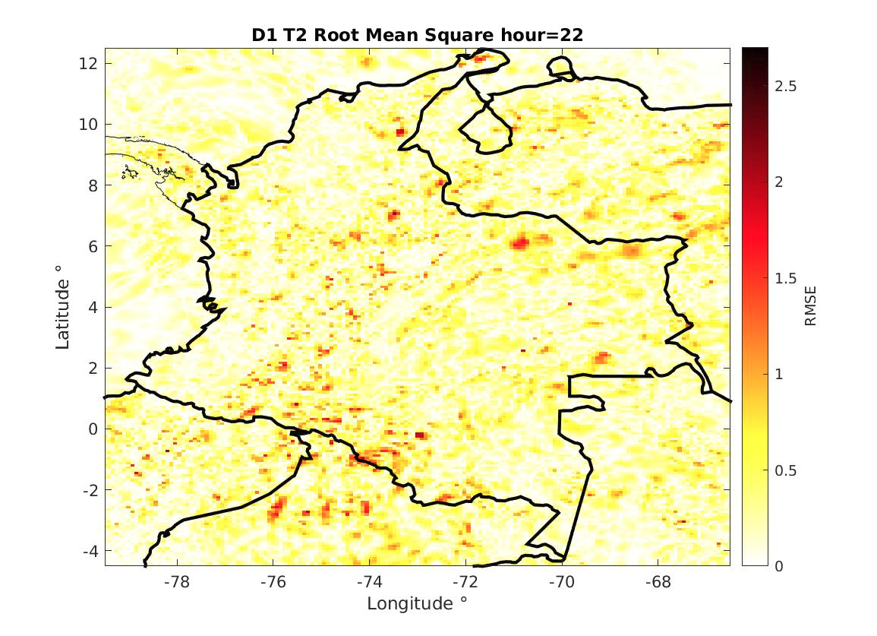
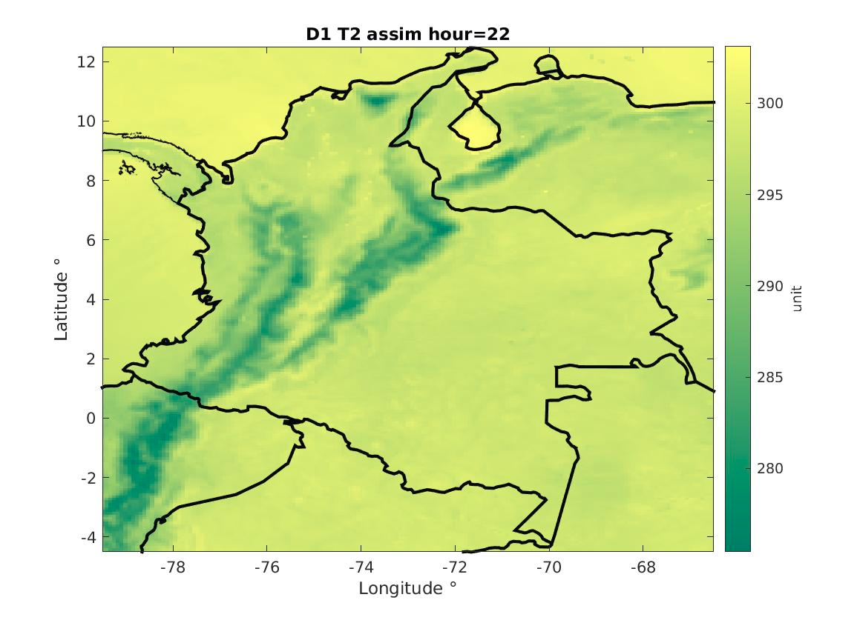
3. Preliminar results
August. Temperature.
15

Slide 16
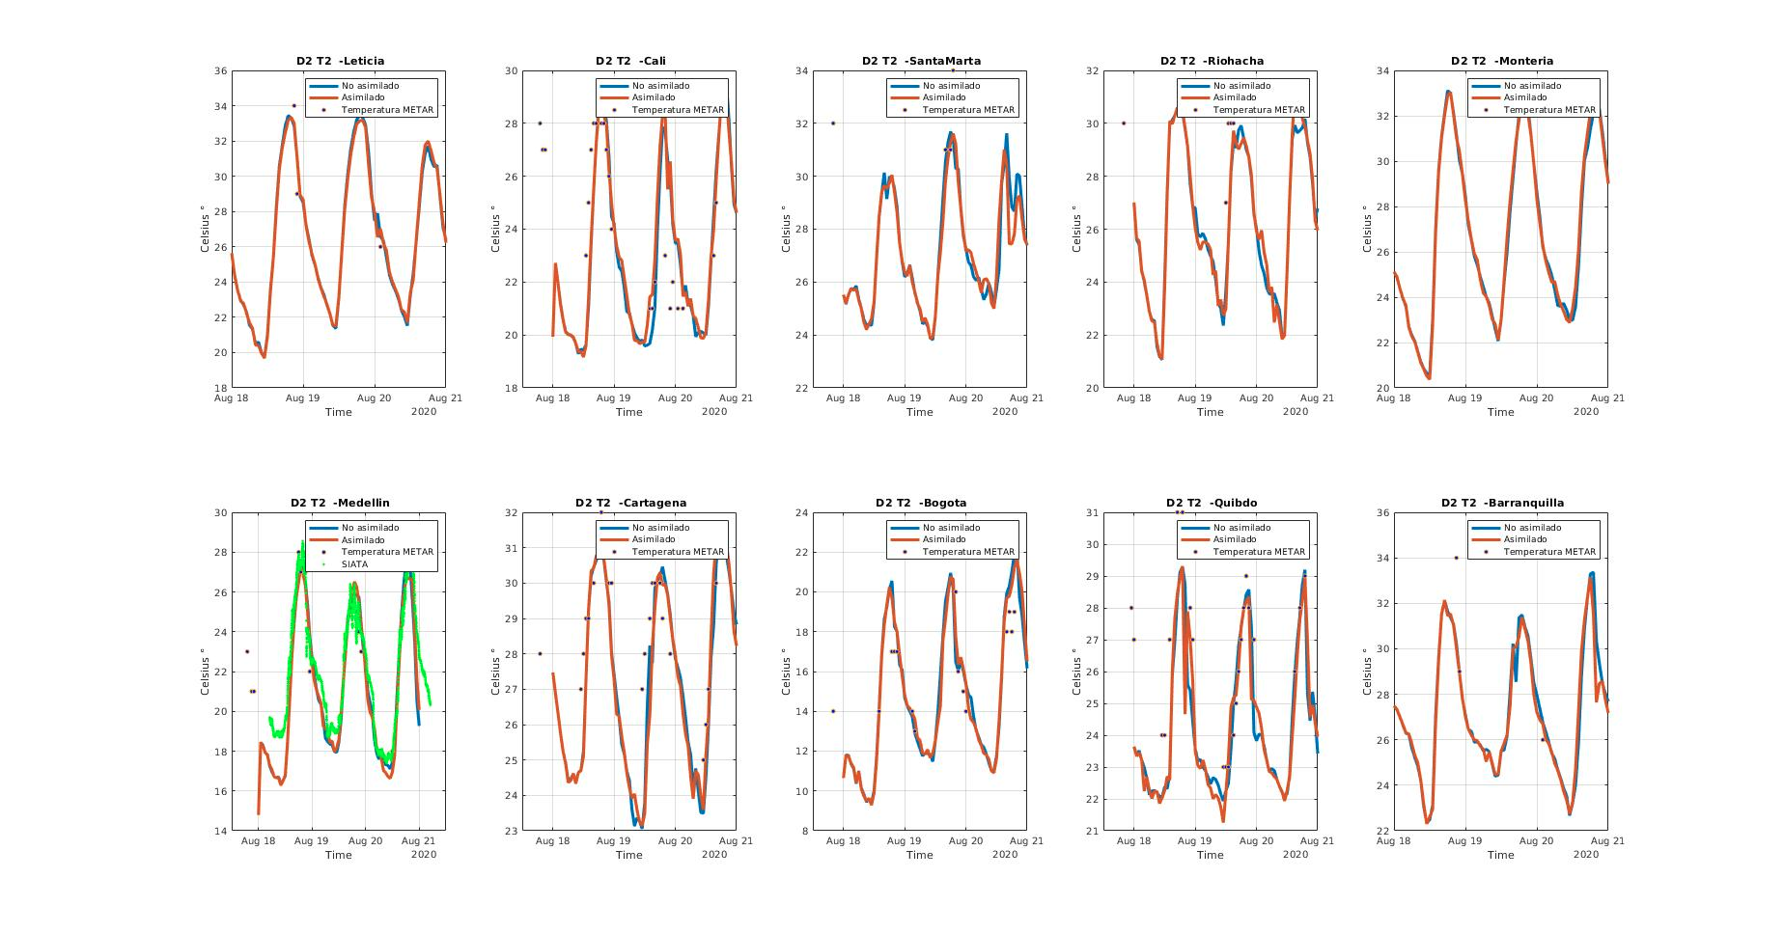
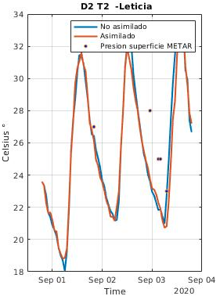
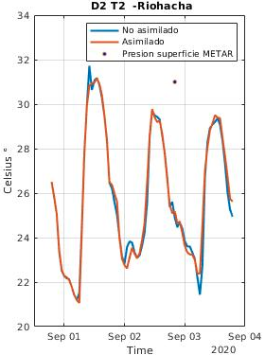
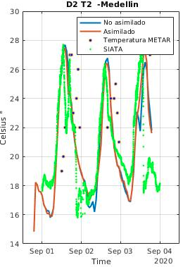
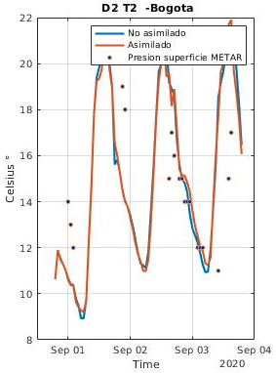
3. Preliminar results
16

Slide 17
 |  | Assimilated |  |  | No Assimilated
 |  | FB | RMSE | CF | FB | RMSE | CF
Amazonian Region | Leticia | -0.1551 | 26.2135 | -0.0595 | -0.1544 | 26.2365 | -0.0579
Caribbean Region | Santa Marta | -0.1662 | 26.4170 | 0.0449 | -0.1635 | 26.4979 | 0.0464
 | Riohacha | -0.1111 | 25.3923 | 0.2057 | -0.1129 | 25.3165 | 0.2381
 | Cartagena | -0.0712 | 20.8515 | 0.5438 | -0.0713 | 20.8145 | 0.5703
 | Barranquilla | -0.1329 | 26.6146 | -0.0912 | -0.1298 | 26.7009 | -0.0806
Pacific Region | Cali | -0.0642 | 18.9651 | 0.2491 | -0.0699 | 18.8349 | 0.2612
 | Quibdó | -0.1037 | 19.4932 | 0.2899 | -0.1023 | 19.5890 | 0.2416
Andean Region | Medellín | -0.1249 | 18.4872 | 0.0893 | -0.1229 | 18.4965 | 0.1029
 | Bogota | -0.1033 | 13.4930 | 0.0945 | -0.1019 | 13.5523 | 0.0738
Statistics. Summary
August. Temperature.
 |  | Assimilated |  |  | No Assimilated
 |  | FB | RMSE | CF | FB | RMSE | CF
Amazonian Region | Leticia | -0.0080 | 25.0075 | -0.1552 | -0.00043914 | 25.2114 | -0.1428
Caribbean Region | Santa Marta | -0.0841 | 25.9628 | -0.0068 | -0.0822 | 26.0133 | -0.0103
 | Riohacha | -0.2222 | 25.5632 | -0.0440 | -0.2243 | 25.5045 | -0.0362
 | Cartagena | -0.1218 | 24.2729 | 0.3151 | -0.1220 | 24.2678 | 0.3118
 | Barranquilla | 0.0325 | 22.6141 | 0.2056 | 0.0351 | 22.6610 | 0.2150
Pacific Region | Cali | 1.9989 | 9.0163e+04 | -0.1534 | 1.9989 | 9.0163e+04 | -0.1507
 | Quibdó | -0.0678 | 20.5050 | 0.1648 | -0.0675 | 20.5302 | 0.1479
Andean Region | Medellín | -0.1292 | 17.8877 | 0.2884 | -0.1300 | 17.8652 | 0.2943
 | Bogota | 0.0391 | 13.4097 | 0.0624 | 0.0401 | 13.4938 | 0.0354
17

Slide 18
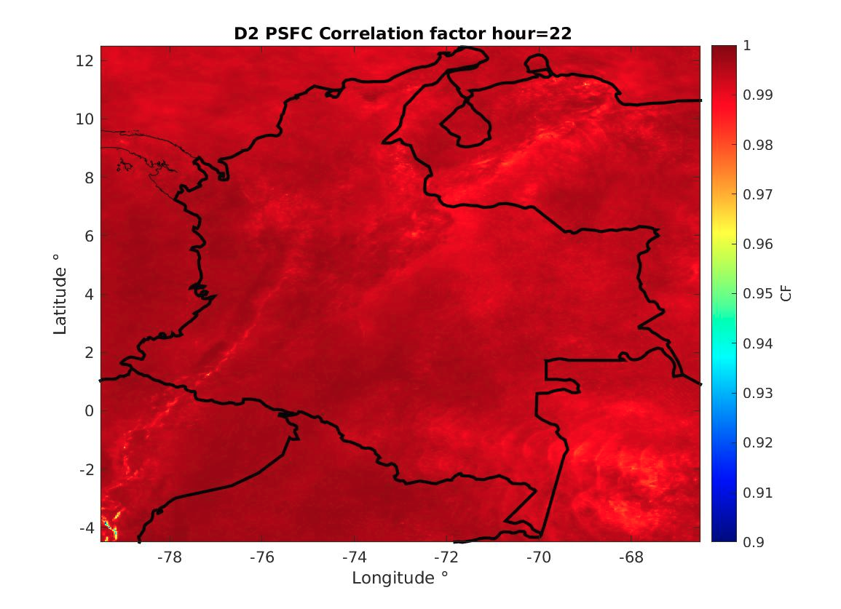
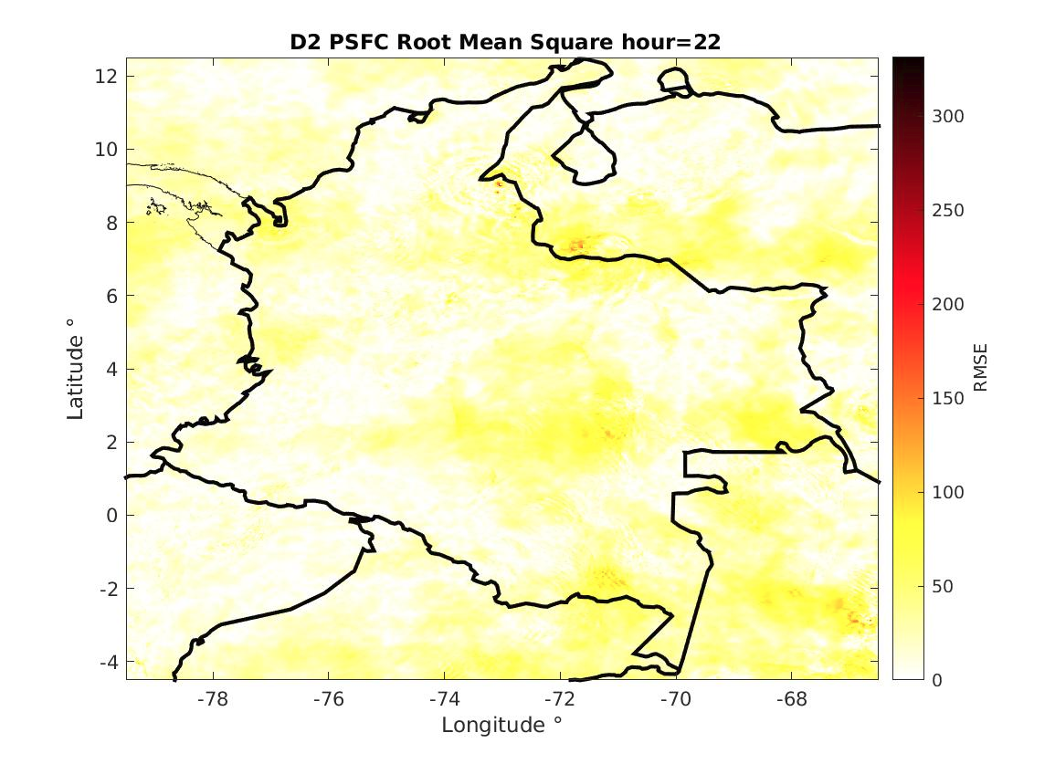
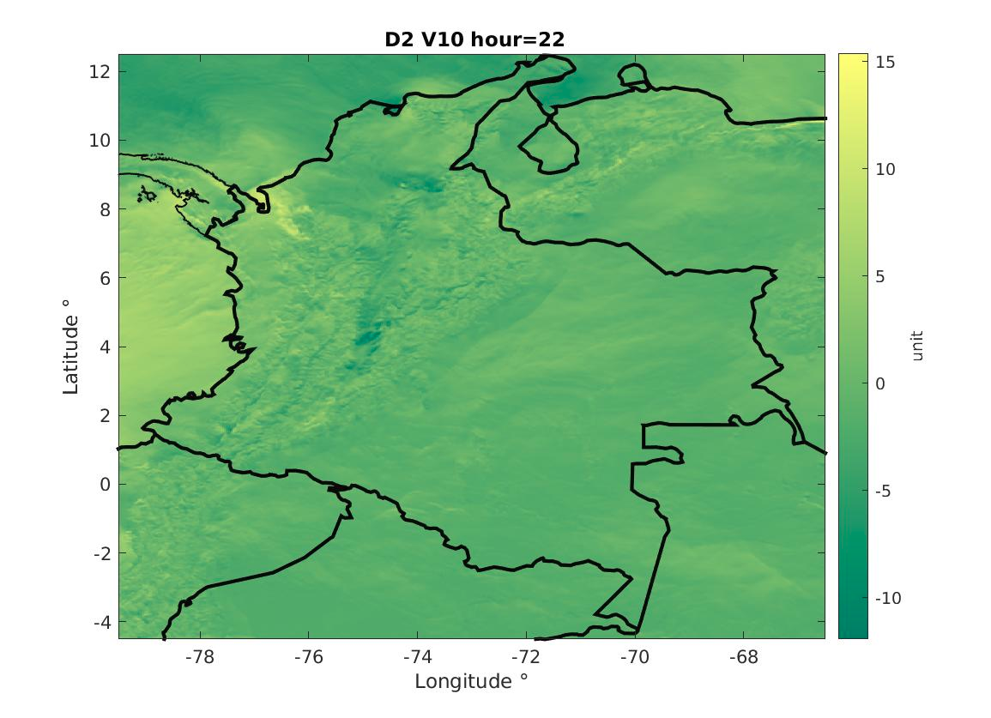
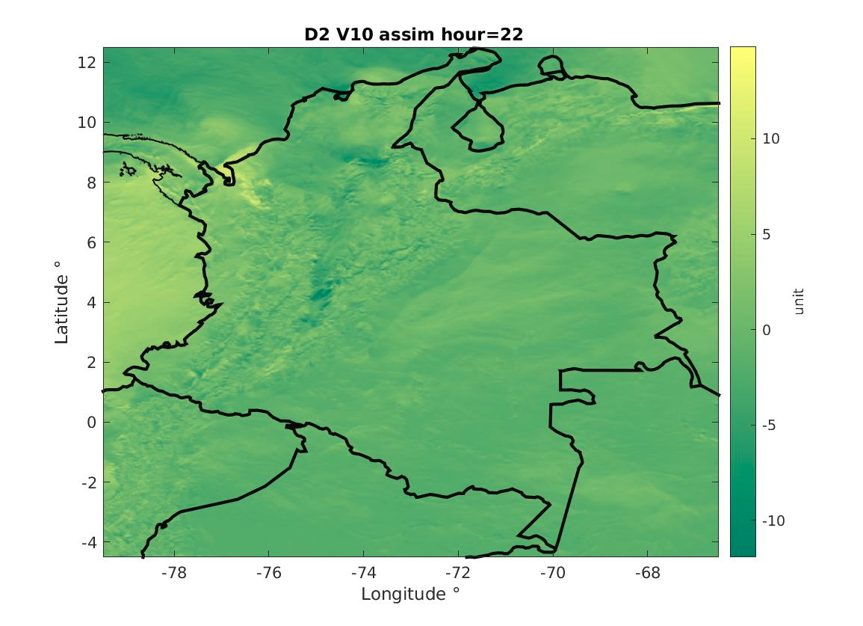
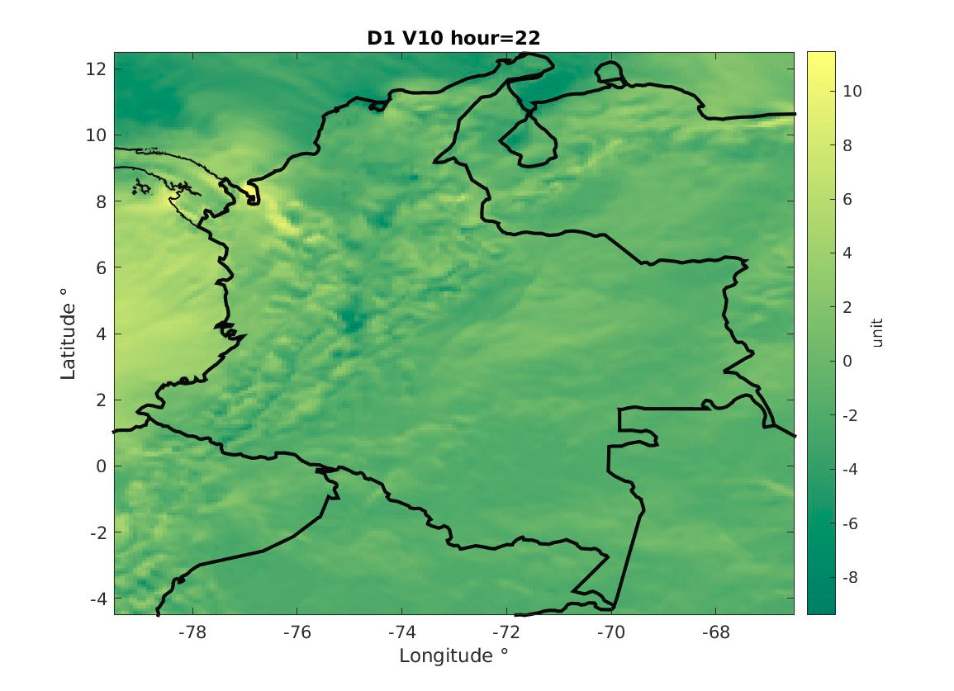
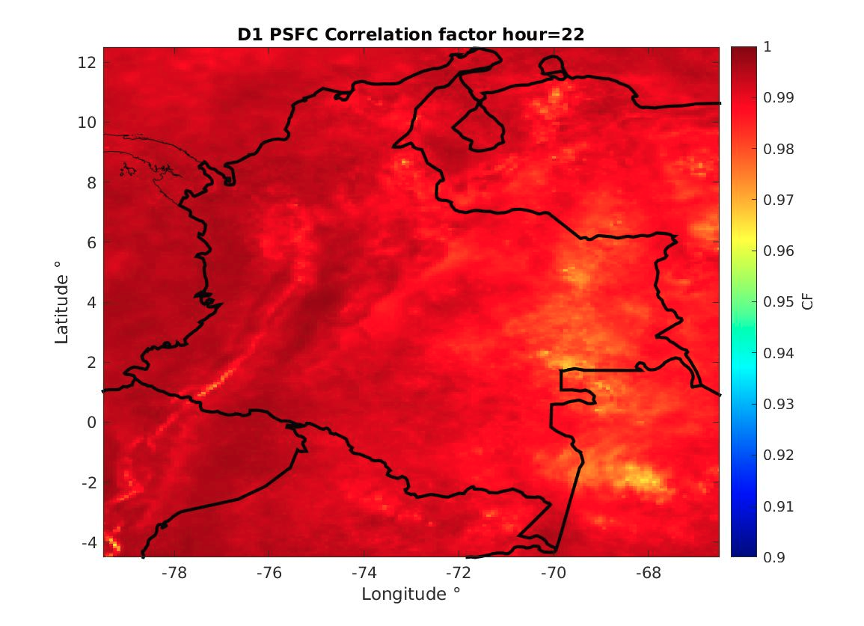
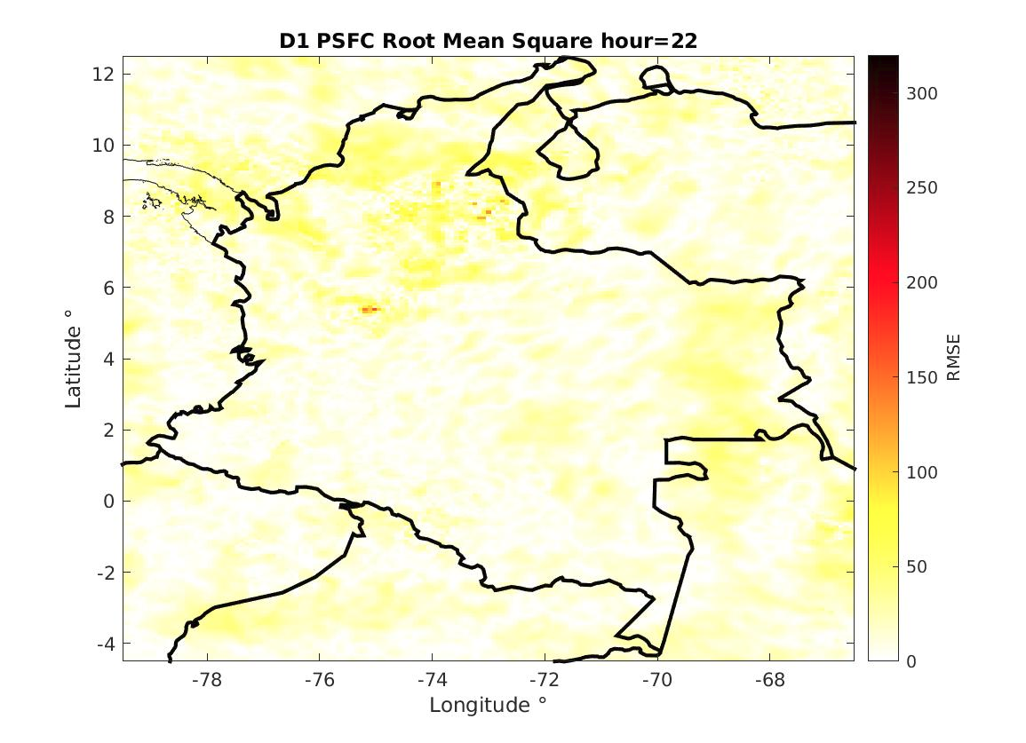
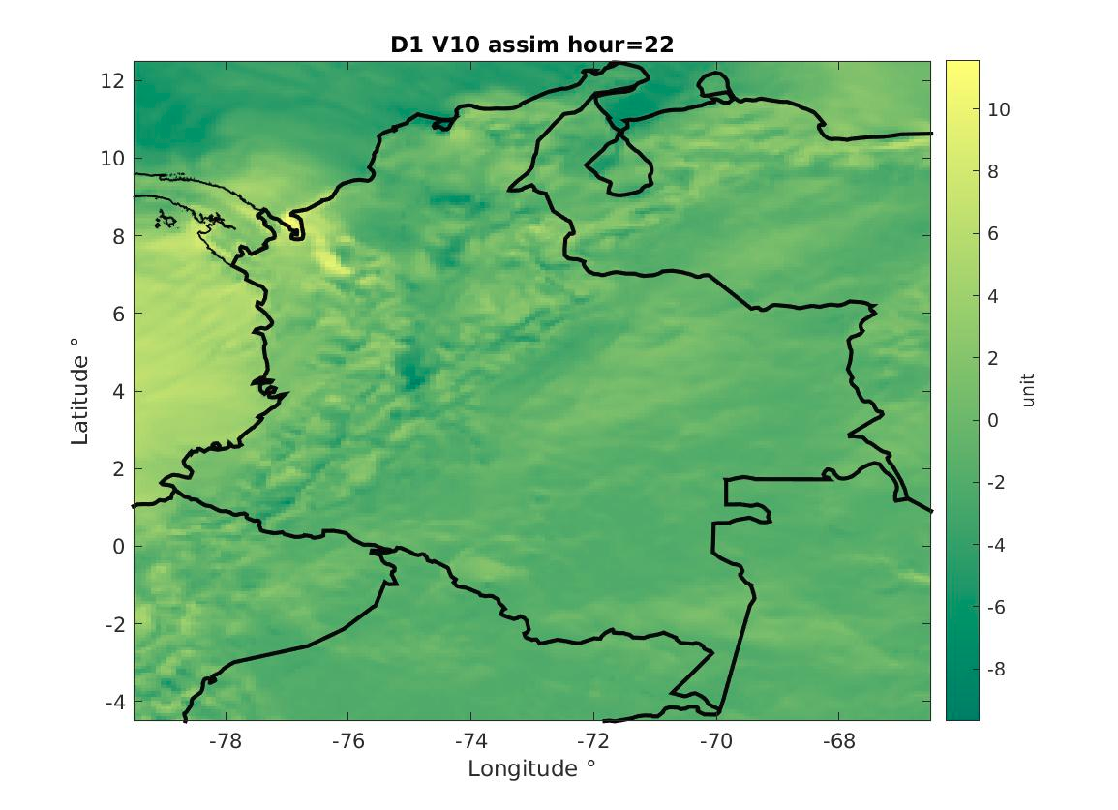
3. Preliminar results
August. Pressure.
18

Slide 19
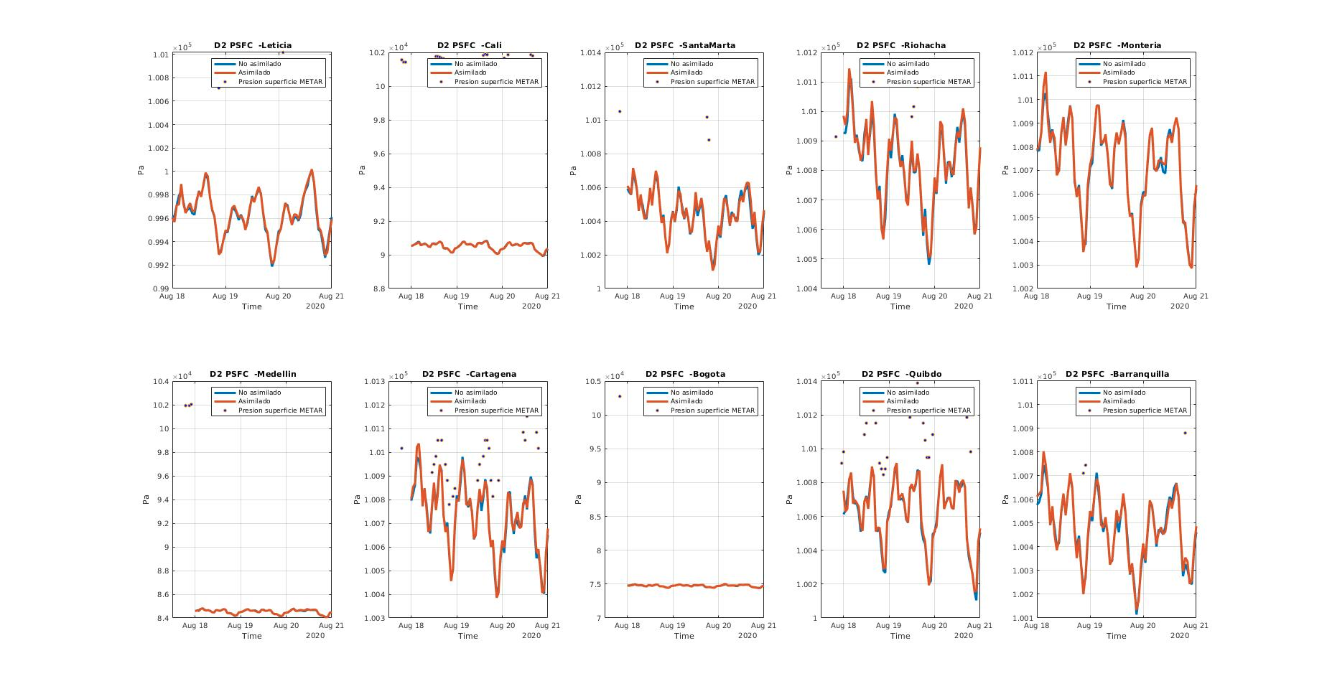
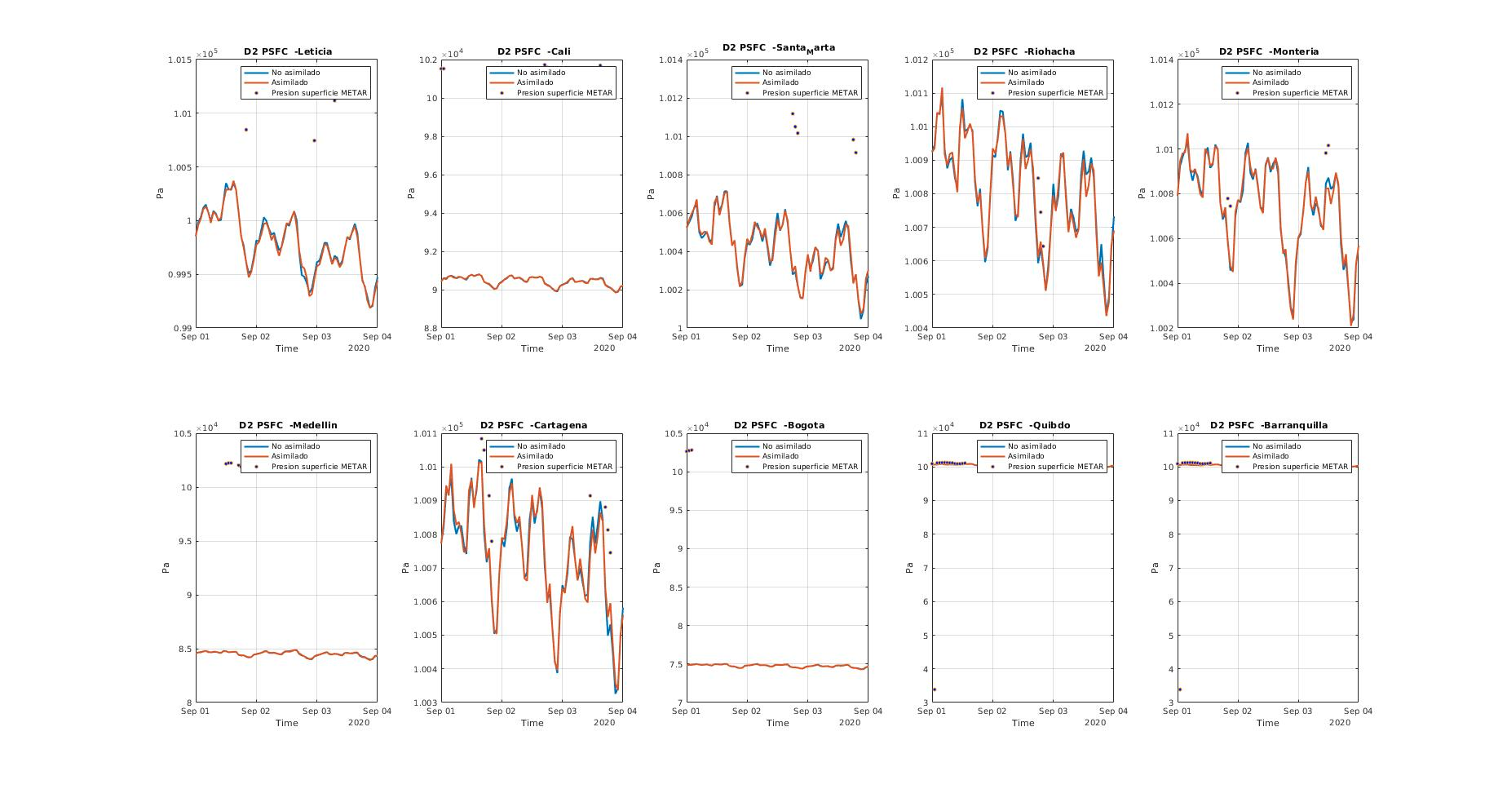
19

Slide 20
 |  | Assimilated |  |  | No Assimilated
 |  | FB | RMSE | CF | FB | RMSE | CF
Amazonian Region | Leticia | -0.0148 | 9.6601e+04 | -0.0125 | -0.0148 | 9.6601e+04 | -0.0152
Caribbean Region | Santa Marta | -0.0086 | 9.7395e+04 | -0.1962 | -0.0087 | 9.7395e+04 | -0.2130
 | Riohacha | -0.0047 | 9.7055e+04 | -0.2624 | -0.0048 | 9.7055e+04 | -0.2770
 | Cartagena | -0.0052 | 7.9772e+04 | -0.3116 | -0.0053 | 7.9768e+04 | -0.3030
 | Barranquilla | -0.0063 | 9.7416e+04 | 0.1440 | -0.0063 | 9.7411e+04 | 0.1605
Pacific Region | Cali | -0.1187 | 7.4987e+04 | -0.2851 | -0.1186 | 7.4990e+04 | -0.2795
 | Quibdó | -0.0074 | 8.1397e+04 | -0.2002 | -0.0074 | 8.1393e+04 | -0.2003
Andean Region | Medellín | -0.1894 | 7.3650e+04 | 0.0430 | -0.1894 | 7.3650e+04 | 0.0632
 | Bogota | -0.3178 | 6.7610e+04 | -0.0805 | -0.3179 | 6.7603e+04 | -0.0534
Statistics. Summary
August. Pressure.
 |  | Assimilated |  |  | No Assimilated
 |  | FB | RMSE | CF | FB | RMSE | CF
Amazonian Region | Leticia | -0.0149 | 9.6052e+04 | -0.0636 | -0.0148 | 9.6062e+04 | -0.0615
Caribbean Region | Santa Marta | -0.0090 | 9.5962e+04 | -0.2945 | -0.0091 | 9.5959e+04 | -0.2987
 | Riohacha | -0.0020 | 9.8457e+04 | -0.0918 | -0.0020 | 9.8462e+04 | -0.0821
 | Cartagena | -0.0045 | 9.3350e+04 | -0.2733 | -0.0046 | 9.3346e+04 | -0.2789
 | Barranquilla | 0.0221 | 8.4101e+04 | 0.0489 | 0.0220 | 8.4098e+04 | 0.0455
Pacific Region | Cali | -0.1180 | 8.2567e+04 | -0.1454 | -0.1179 | 8.2568e+04 | -0.1417
 | Quibdó | 0.0231 | 8.4191e+04 | -0.0013 | 0.0231 | 8.4195e+04 | -0.0053
Andean Region | Medellín | -0.1898 | 7.4288e+04 | -0.1300 | -0.1898 | 7.4289e+04 | -0.1259
 | Bogota | -0.3178 | 6.5671e+04 | -0.1396 | -0.3178 | 6.5670e+04 | -0.1272
20

Slide 21
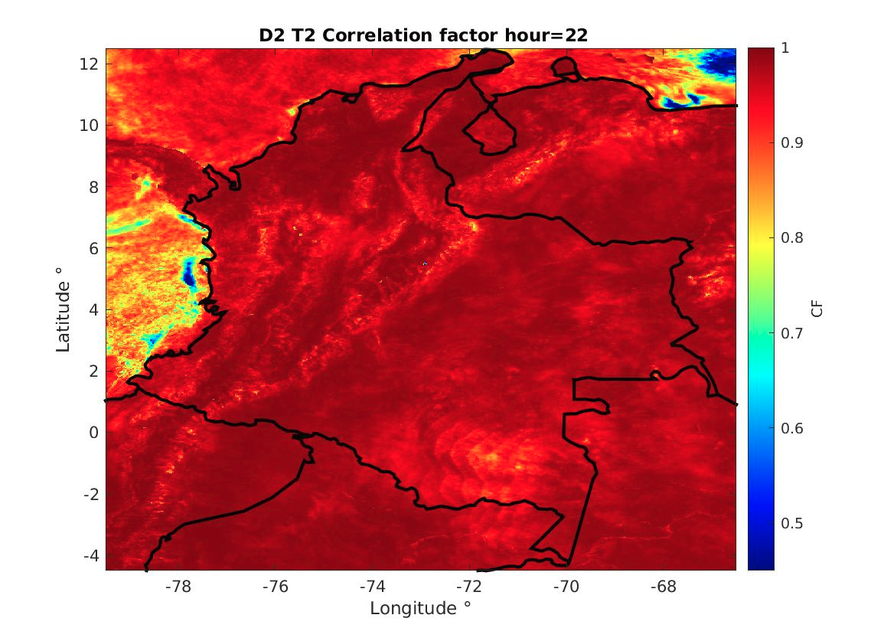
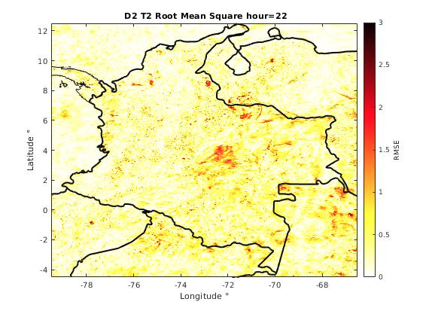
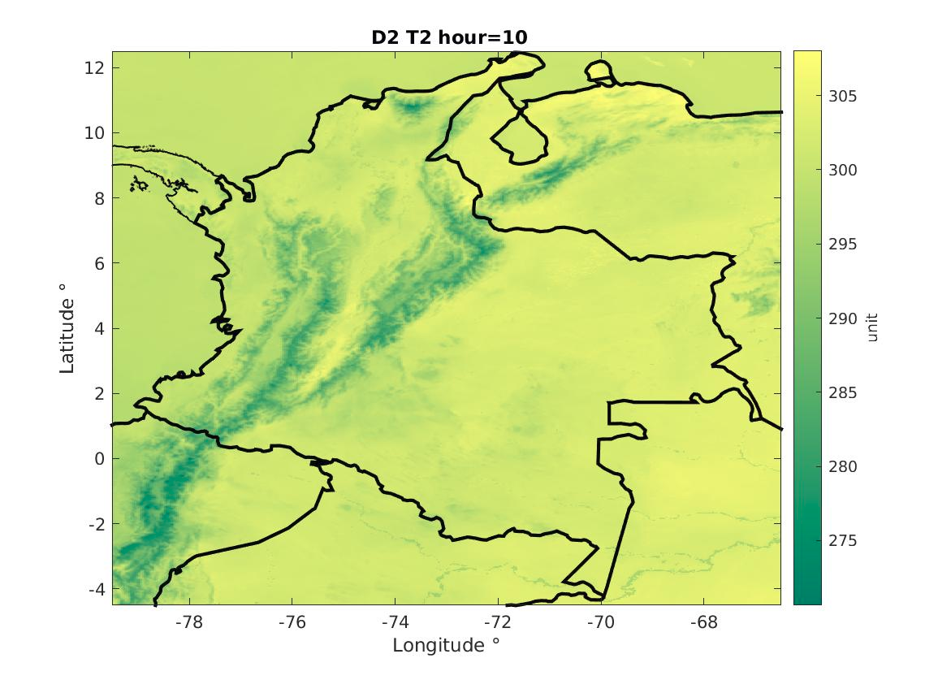





Statistics
September. Temperature.
21

Slide 22




22

Slide 23




23

Slide 24


24

Slide 25




3. Preliminar results
Initial condition increment August 18 - 00 horas Domain 1
25

Slide 26







3. Preliminar results
Initial condition increment September 1- 00 horas Domain 2
26

Slide 27


27

Slide 28





28

Slide 29
3. Preliminar results
Contingency table run 20200818-00
 | Observed(313)
Forecast WRF D1 |  | Rain157 | No rain 156
 | Rain | 149 | 152
 | No rain | 8 | 13
Bias = 1.86
PC = 0.517
POD = 0.949
FAR = 0.489
ETS = 0.0165
HSS = 0.0324
PSS = 0.0323
CSS = 0.1293
Bias = 1.86
PC = 0.533
POD = 0.968
FAR = 0.481
ETS = 0.0333
HSS = 0.0644
PSS = 0.0643
CSS = 0.2687
 | Observed(313)
Forecast WRFDA D1 |  | Rain157 | No rain156
 | Rain | 152 | 141
 | No rain | 5 | 15
PROPORTION CORRECT
(PC)
PROBABILITY OF DETECTION
(POD)
FALSE ALARM RATIO
(FAR)
EQUITABLE THREAT SCORE
(ETS)
HEIDKE SKILLSCORE
(HSS)
PEIRCE SKILLSCORE
(PSS)
CLAITON SKILLSCORE
(CSS)
 | Observed(308)
Forecast WRF D2 |  | Rain157 | No rain 156
 | Rain | 153 | 148
 | No rain | 4 | 8
Bias = 1.92
PC = 0.514
POD = 0.974
FAR = 0.491
ETS = 0.0131
HSS = 0.0258
PSS = 0.0258
CSS = 0.1749
 | Observed(308)
Forecast WRFDA D2 |  | Rain157 | No rain156
 | Rain | 153 | 146
 | No rain | 4 | 10
Bias = 1.90
PC = 0.52
POD = 0.974
FAR = 0.488
ETS = 0.01975
HSS = 0.0387
PSS = 0.0386
CSS = 0.2259
29

Slide 30
3. Preliminar results
Contingency table run 20200901-00
 | Observed(308)
Forecast WRF D1 |  | Rain138 | No rain 170
 | Rain | 130 | 146
 | No rain | 8 | 24
Bias = 2.0
PC = 0.5
POD = 0.942
FAR = 0.528
ETS = 0.0395
HSS = 0.076
PSS = 0.0832
CSS = 0.221
Bias = 2.05
PC = 0.512
POD = 0.985
FAR = 0.521
ETS = 0.0551
HSS = 0.1045
PSS = 0.1149
CSS = 0.3955
 | Observed(308)
Forecast WRFDA D1 |  | Rain138 | No rain170
 | Rain | 136 | 148
 | No rain | 2 | 22
PROPORTION CORRECT
(PC)
PROBABILITY OF DETECTION
(POD)
FALSE ALARM RATIO
(FAR)
EQUITABLE THREAT SCORE
(ETS)
HEIDKE SKILLSCORE
(HSS)
PEIRCE SKILLSCORE
(PSS)
CLAITON SKILLSCORE
(CSS)
 | Observed(308)
Forecast WRF D2 |  | Rain(138) | No rain(170)
 | Rain | 131 | 144
 | No rain | 7 | 26
Bias = 1.99
PC = 0.509
POD = 0.949
FAR = 0.523
ETS = 0.049
HSS = 0.0934
PSS = 0.1022
CSS = 0.2642
 | Observed(308)
Forecast WRFDA D2 |  | Rain138 | No rain170
 | Rain | 134 | 145
 | No rain | 4 | 25
Bias = 2.02
PC = 0.516
POD = 0.971
FAR = 0.519
ETS = 0.0569
HSS = 0.1077
PSS = 0.1180
CSS = 0.3423
30

Slide 31

3. Preliminar results
WRF |  | WRFDA
D1 | D2 | D1 | D2
62.7% | 60.3% | 61.6% | 60.3%
47.7% | 44.7% | 49.4% | 43.8%
77% | 81.7% | 79.4% | 79.4%
77.7% | 77.7% | 88.8% | 88.8%
22.2% | 22.2% | 22.2% | 22.2%
Run 20200818-00
31

Slide 32
3. Preliminar results
WRF |  | WRFDA
D1 | D2 | D1 | D2
51.1% | 54.1% | 52.6% | 54.1%
54.6% | 50% | 52.4% | 51.1%
33.3% | 47.2% | 25% | 36.1%
77.7% | 88.8% | 77.7% | 77.7%
55.6% | 66.6% | 55.6% | 55.6%
Run 20200901-00
32

Slide 33


Amazonian Region
33

Slide 34


Caribbean Region
34

Slide 35


Orinoquia Region
35

Slide 36


PacificRegion
36

Slide 37







4. Current and future work
Y
x
Hypograph
characterization
Signal acquisition
Signal smoothing
37

Slide 38
4. Current and future work
SOTO “Sensitivity analysis for different observation sources assimilation ”
JHON “PBL estimation through Data assimilation WRF experiments”
38

Slide 39
Next steps checklist
Imágenes a las resolución del WRF– Sara, las pasa a la matriz Sara y Andrés 80%
Imágenes radar desde el Little R—Soto, las pasa a la matriz Andrés y Soto 60%
Código METAR generalizado para generar la matriz Jhon
Código Sondas generalizado para generar la matriz Andrés
Leer el articulo cada uno y dar un feedback
Repetir experimentos de precipitación
Comparación vertical sondas Yarce Soto Jhon
Generar capas verticales Alturas←→Presiones Soto y Jhon
Soto. Preguntar datos de volumen de helio usado para estimar velocidades de ascenso. Tipo de globo.
39

Slide 40
Metodología de armada de cubo en el documento del texto
Asimilación de datos, una crítica de como vemos el proceso de asimilación de datos
40

Slide 41
Estructura integración de los códigos de observaciones
Github base https://github.com/ayarceb/WRFDA_FAC_EAFIT
Usuario → ingresa Fecha → selecciona observaciones
Sondas (multi-descarga, extracción variables de interés)
Metar (multi-descarga, extracción P y T)
Radar (Extracción desde el Little R de las variables de interés)
GOES (técnica de remapeo desde las imágenes, normalización)
Unidades aeroportadas Simple (unidades complementarias de información de calidad de aire y meteorología)
Matrices “Hipercubos”
Información interpolada espacio-temporalmente a la resolucion del modelo operativo WRFDA FAC
Pipeline descarga, preprocesamiento y análisis de datos de diferentes observaciones sobre el territorio Colombiano
41

Slide 42
Pipeline sounding
Download
Erase label information of the downloaded file for each sounding station
Generate hiper matrix
Lat,Lon,levels, time
Convert to .txt
Save as day_station.mat
Load day_station.mat
d2sounds.py
/home/dirac/Dropbox/2020/WRFDA_FAC_EAFIT/Sondas/Descarga_Sondas/new_download
Read .txt
readtable(<station>.txt)
Validation of the trajectory: save station file as .dat and use pymeteo
For produce skewt.pdf

Slide 43

Pipeline GOES

Slide 44

Pipeline METAR
Download
Decode Metar
Hipe Matrix
From IDEAM:
http://www.ideam.gov.co/web/meteorologia-aeronautica/consulta-metar
Select: Station, date/time (start and end), type of report (METAR-SPECI)
GITHUB:
https://github.com/ayarceb/WRFDA_FAC_EAFIT/tree/master/Metar/decode_metar.py
Review the file obtained. Delete information repeat.
Generate hiper matrix with dimension Lat,Lon,levels, time and using the information of the WRFOUT for every variable.
GITHUB:
https://github.com/ayarceb/WRFDA_FAC_EAFIT/tree/master/Metar/decode_metar.py

Slide 45

Pipeline RADAR
Download
From SIMFAC:
https://www.simfac.mil.co/imag/RADAR/RAW/ raw files
p2_preparation.py
decodeRADAR.py
Csv_2_matrix
Data radar in csv
Hipe Matrix
Files in little R
Generate a csv matrix with Fecha, Lat,Lon,altura, radial velocity, reflectivity
GITHUB:
https://github.com/ayarceb/WRFDA_FAC_EAFIT/tree/master/RADAR/decodeRADAR.py
Generate hiper matrix with dimension Lat,Lon,levels, time and using the information of the WRFOUT for every variable.
GITHUB:
https://github.com/ayarceb/WRFDA_FAC_EAFIT/tree/master/RADAR/csv_2_matrix.py

Slide 46
General automatic pipeline observations
Selección periodo de tiempo
Selección de estaciones
Sondas
METAR
Satellite
(GOES
Sentinel-5
Sentinel-2)
RADAR
Precipitación
IDEAM
Simple unit
CSV
Usuario
Matrix interface
Base de datos
Data assimilation validation purposes

Slide 47
SimpleSpace airborne unit
http://3.139.59.142:8501/
47

Slide 48
4. Current and future work
Does assimilation reduce the model-model, model-data gap errors?
How could we validate the Air Force operational model under conditions of data assimilation?
Which is the nature of the errors presented?(Assimilation or model parametrizations)
Research questions
48

Slide 49
4. Preliminar conclusions
The changes in the model assimilated are not representative compared the non assimilated for the surface variables
Variables such precipitation have good performance in Caribbean region, Andean region, Orinoquia region
The knowledge acquired provide important technical aspects to future interaction with the WRFDA operative assimilation Colombian Air Force. Convergence criterias, change in iteration number and observation error matrix interactions must be studied.
El proceso de asimilación de datos de datos tiene una buena respuesta dinámica
Pipeline que reduzca los esquemas de localización, fines de comando y control minimización de riesgos
49

Slide 50
4. References
Cáceres, R. H. (2018). Impacto de la asimilación radar en el pronóstico de precipitación a muy corto plazo usando el modelo WRF
Cáceres, R. H. (2017). Meteorología aplicada a la seguridad de las operaciones aéreas.
Martínez (2015). Análisis de las condiciones a escala local para el pronóstico de niebla o neblina en el aeródromo “Ernesto Esguerra Cubides".
Aragón (2015). Análisis de las condiciones meteorológicas asociadas con la presencia de sistemas convectivos en el aeropuerto El Dorado de Bogotá D.C.
Jimenez, M. (2014) Validación de la capacidad del modelo WRF “Weather Research and Forecasting” para pronosticar lluvia intensa, usando el método orientado a objetos y tablas de contingencia.
50

